Slide 1
Chapter 8: Arrays and the ArrayList Class
Starting Out with Java: From Control Structures through Objects
Fourth Edition
by Tony Gaddis

Slide 2
Chapter Topics
Chapter 8 discusses the following main topics:
Introduction to Arrays
Processing Array Contents
Passing Arrays as Arguments to Methods
Some Useful Array Algorithms and Operations
Returning Arrays from Methods
String Arrays
Arrays of Objects

Slide 3
Chapter Topics
Chapter 8 discusses the following main topics:
The Sequential Search Algorithm
Parallel Arrays
Two-Dimensional Arrays
Arrays with Three or More Dimensions
The Selection Sort and the Binary Search
Command-Line Arguments
The ArrayList Class

Slide 4
Introduction to Arrays
Primitive variables are designed to hold only one value at a time.
Arrays allow us to create a collection of like values that are indexed.
An array can store any type of data but only one type of data at a time.
An array is a list of data elements.

Slide 5
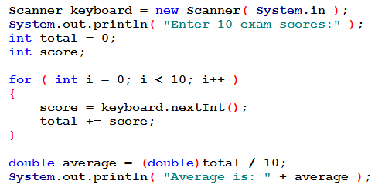
Why Use an Array?
I want to read some test scores in and report the average:

Slide 6
Why Use an Array?
What if I want to know how far above or below the average each score is?
Oops. I no longer have access to the scores!
What can I do?
I could declare 10 variables for scores.
Each would need to be read separately.
I wouldn't use a loop, just read and read and ...
This won't scale well: what if there are 100 students?
I could use an array of 10 elements.

Slide 7
Creating and Accessing Arrays
An array is a special kind of object
Think of an array as collection of variables of the same type

Slide 8
Creating Arrays
An array is an object so it needs an object reference.
// Declare a reference to an array
// of integers.
int[] numbers
This declaration creates an array reference/name – there is NO array yet.
The next step creates the array and assigns its address to the numbers variable.
// Create a new array that will hold
// 6 integers.
numbers = new int[6];

Slide 9
Creating Arrays
This is the array created on the previous slide:
Notice that array elements are automatically initialized.
Remember that array indexes/subscripts always start at 0.
0
0
0
0
0
0
index 0
index 1
index 2
index 3
index 4
index 5

Slide 10
Creating Arrays
It is possible to declare an array reference and create it in the same statement.
int[] numbers = new int[6];
Arrays may be of any type.
float[] temperatures = new float[100];
char[] letters = new char[41];
long[] units = new long[50];
double[] sizes = new double[1200];

Slide 11
Creating Arrays
The array size must be a non-negative number.
It may be a literal value, a constant, or variable.
final int ARRAY_SIZE = 6;
int[] numbers = new int[ARRAY_SIZE];
It's common to use a final variable (i.e. a constant) as a size declarator, which makes the program easier to maintain.
Once created, an array size is fixed and cannot be changed.

Slide 12
Accessing the Elements of an Array
20
0
0
0
0
0
numbers[0]
numbers[1]
numbers[2]
numbers[3]
numbers[4]
numbers[5]
An array is accessed by:
the reference name
a subscript that identifies which element in the array to access.
numbers[0] = 20;
// pronounced "numbers sub zero"
// or simply "numbers zero"

Slide 13
Creating and Accessing Arrays
Use an index/subscript (0-based) to access array elements:
numbers[0] is the first element
numbers[1] is the second element
etc.
If the array has n elements, the last element is numbers[n-1].
If the subscript is outside the bounds of the array (0 to n-1), an "array index out of bounds" exception occurs. Make it a priority to ensure that this CANNOT happen in your programs!

Slide 14
Square Brackets with Arrays
With a data type when declaring an array int [ ] pressure;
To enclose an integer expression to declare the length of the array pressure = new int [100];
Note that the indices will run 0 to 99
To name an indexed value of the array pressure[3] = keyboard.nextInt();

Slide 15
Inputting and Outputting Array Elements
Array elements can be treated as any other variable.
They are simply accessed by the same name and a subscript.
See example: ArrayDemo1.java

Slide 16
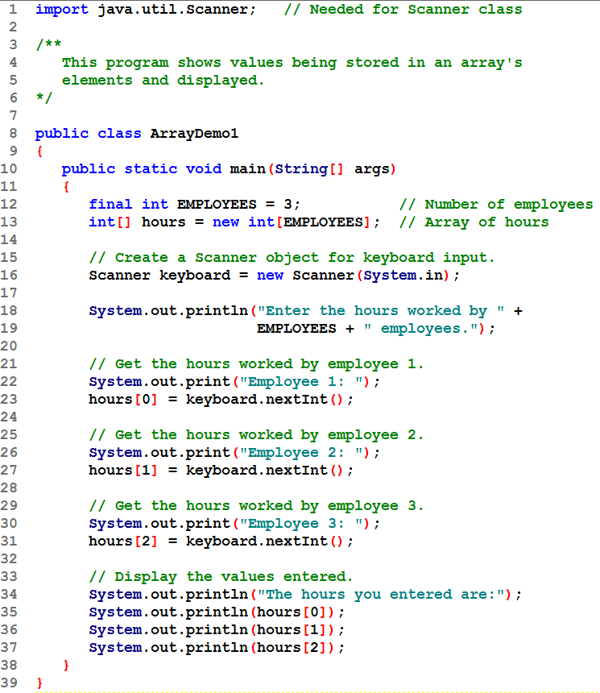
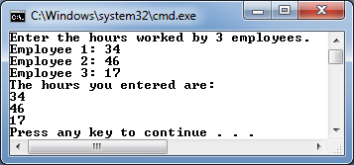
First the array is declared and created.
Then each element is assigned a value.
Then each element’s value is output.

Slide 17
Inputting and Outputting Array Elements
Array subscripts can be accessed using variables (such as for loop counters).
See example: ArrayDemo2.java

Slide 18
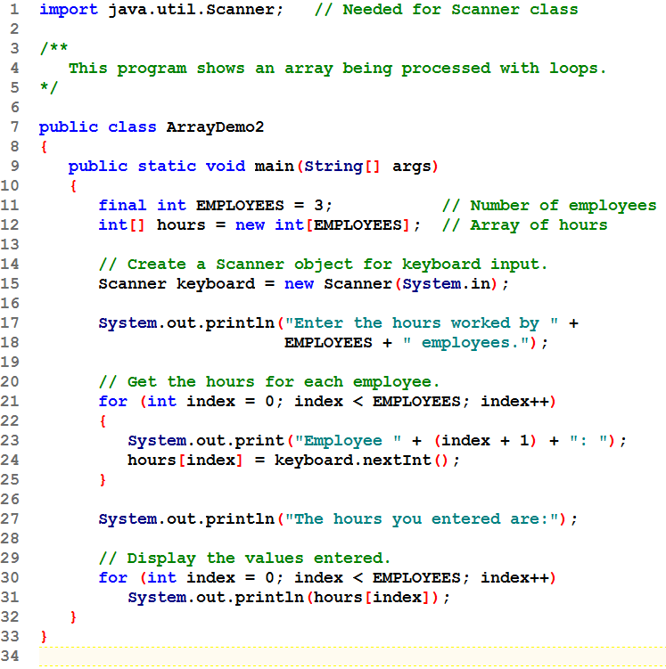
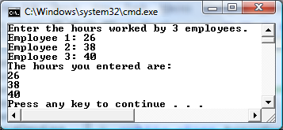
First the array is declared and created.
A loop is used to assign a value to each element.
Then a loop is used to output each element’s value.

Slide 19
Bounds Checking
Array indexes always start at zero and continue to (array length - 1).
int values = new int[10];
This array would have indexes 0 through 9.
See example: InvalidSubscript.java
In for loops, it is typical to use i, j, and k as counting variables.
It might help to think of i as representing the word index.

Slide 20
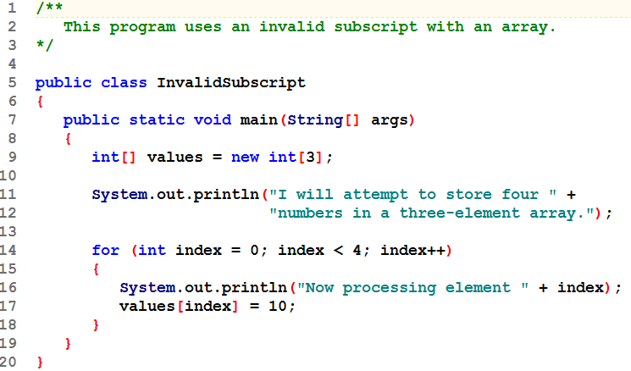
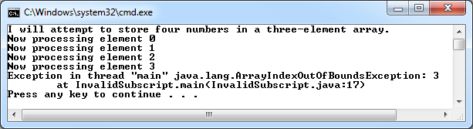

Slide 21
Off-by-One Errors
It is very easy to be off-by-one when accessing arrays.
// This code has an off-by-one error.
int[] numbers = new int[100];
for (int i = 1; i <= 100; i++)
numbers[i] = 99;
Here, the equal sign allows the loop to continue on to index 100, where 99 is the last index in the array.
This code would throw an ArrayIndexOutOfBoundsException.

Slide 22
Array Initialization
Arrays are automatically initialized, no matter where declared (instance or local).
numeric to 0
boolean to false
references to null

Slide 23
Array Initialization
When relatively few items need to be initialized, an initialization list can be used to initialize the array.
int[]days = {31, 28, 31, 30, 31, 30, 31,
31, 30, 31, 30, 31};
The array's length is determined by the number of initializers. Here the length is 12.
The numbers in the list are stored in the array in order:
days[0] is assigned 31,
days[1] is assigned 28,
days[2] is assigned 31,
etc.
See example: ArrayInitialization.java

Slide 24
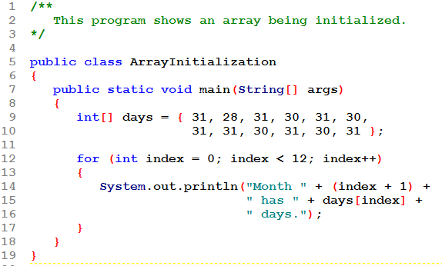
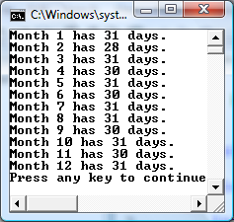
Note you don't use the word new when using an initialization list.
Note the use of (index + 1) in the println(). The array index is one less than the "usual" month number we want to display, so we adjust by adding 1 to the index before displaying it.

Slide 25
Alternate Array Declaration
Previously we showed arrays being declared:
int[] numbers;
However, the brackets can also go here:
int numbers[];
These are equivalent but the first style is typical.

Slide 26
Alternate Array Declaration
Multiple arrays can be declared on the same line.
int[] numbers, codes, scores;
With the alternate notation each variable must have brackets.
int numbers[], codes[], scores;
The scores variable in this instance is simply an int variable.

Slide 27
END CHAPTER 8-1

Slide 28
Processing Array Contents
Processing data in an array is the same as any other variable.
grossPay = hours[3] * payRate;
Pre and post increment works the same:
int[] score = {7, 8, 9, 10, 11};
++score[2]; // Pre-increment operation
score[4]++; // Post-increment operation
See example: PayArray.java

Slide 29
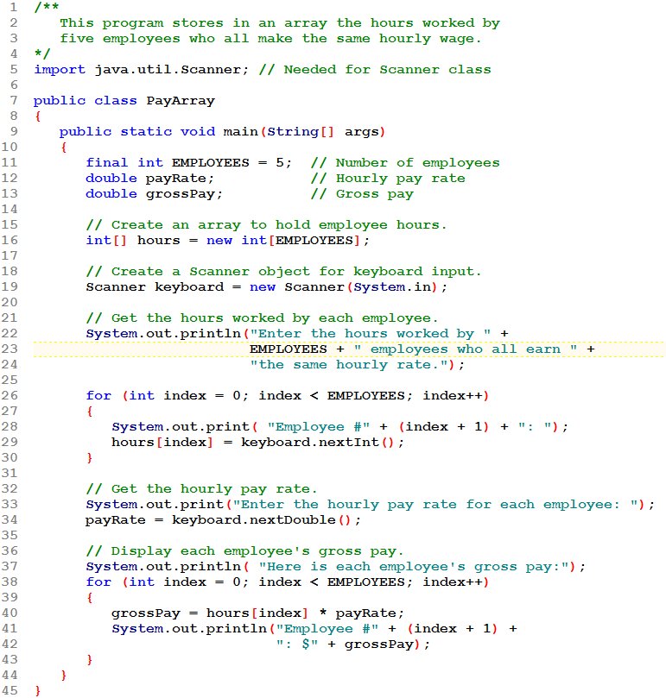
Create the array using a constant for its size.
The constant is used to display a prompt.

Slide 30
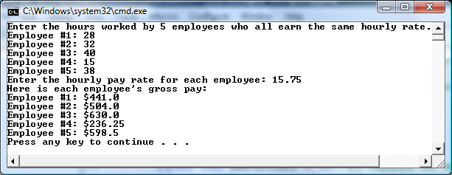
Loop to read in values. Use the constant to control this loop.
Loop to compute and output results. Use the constant again.

Slide 31
Processing Array Contents
Array elements can be used in relational operations:
if(cost[20] < cost[0])
{
//statements
}
They can be used as loop conditions:
while(value[count] != 0)
{
//statements
}

Slide 32
Array Length
Arrays are objects and provide a public field named length that is a constant that can be tested.
The length of this array is 25.
double[] temperatures = new double[25];
The length of an array can be obtained via its length constant.
The variable size will contain 25.
int size = temperatures.length;

Slide 33
Array Length
It is common to use the length property to control loops when the entire array is being processed.
See revised example: PayArray2.java

Slide 34
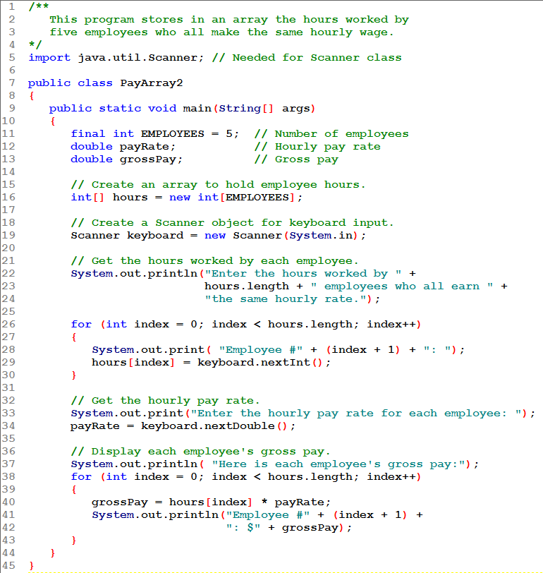
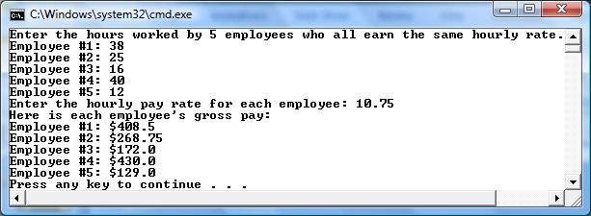
Create the array using a constant for its size.
Use the array's length property in the prompt.

Slide 35
Loop to read in values. Use the length property to control this loop.
Loop to compute and output results. Use the length property again.
Note that the loop test is index < hours.length. Watch that you don't use <= by mistake, creating an arrayIndexOutOfBounds Exception.

Slide 36
The Enhanced for Loop
Simplified array processing (read only)
Always goes through all elements
General format:
for(datatype elementVariable : array)
statement;
The datatype must either be the same type as the array's, or something the elements can be automatically converted to.

Slide 37
The Enhanced for Loop
Example:
int[] numbers = {3, 6, 9};
for(int val : numbers)
{
System.out.println("The next value is " +
val);
}

Slide 38
The Enhanced for Loop
Although this is simpler and commonly used, you cannot use it:
if you need to change the value of an element.
if you need to go backward through the array
if you need to access only some of the elements
if you need to work with 2 (or more) arrays simultaneously within the loop
if you need to refer to a subscript for any reason

Slide 39
Array Size
You can let the user specify the size of an array:
int numTests;
int[] tests;
Scanner keyboard = new Scanner(System.in);
System.out.print("How many tests do you have? ");
numTests = keyboard.nextInt();
tests = new int[numTests];
See example: DisplayTestScores.java

Slide 40
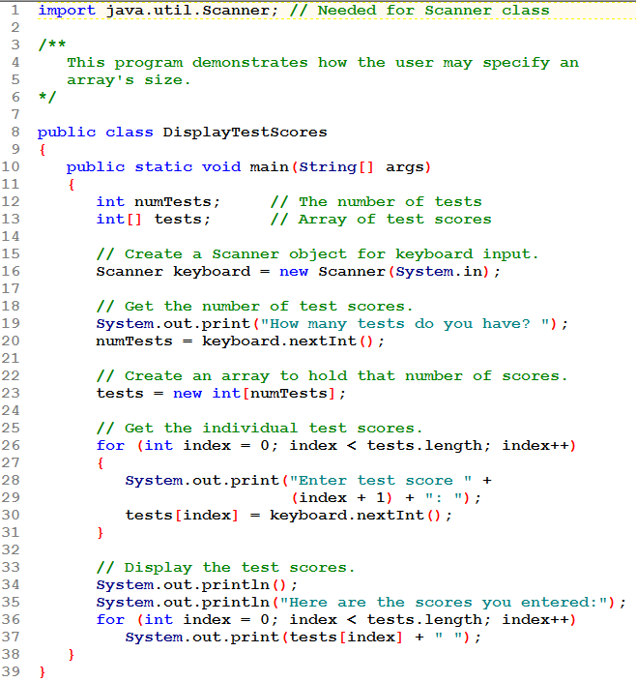
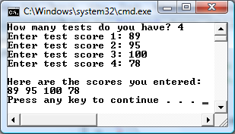
Notice that the array is declared in line 13 and created in line 23, after the user had given the number of elements.

Slide 41
Reassigning Array References
An array reference can be assigned to another array of the same type.
// Create an array referenced by the numbers variable.
int[] numbers = new int[10];
// Reassign numbers to a new array.
numbers = new int[5];
If the first (10 element) array no longer has a reference to it, it will be garbage collected.

Slide 42
Reassigning Array References
int[] numbers = new int[10];
The numbers variable
holds the address of an
int array.
Address

Slide 43
Reassigning Array References
This array gets marked for
garbage collection
The numbers variable
holds the address of an
int array.
Address
numbers = new int[5];

Slide 44
Copying Arrays
This is not the way to copy an array.
int[] array1 = { 2, 4, 6, 8, 10 };
int[] array2 = array1; // This does not copy array1.
2
4
6
8
10
array1 holds an
address to the array
Address
Example: SameArray.java
array2 holds an
address to the array
Address

Slide 45
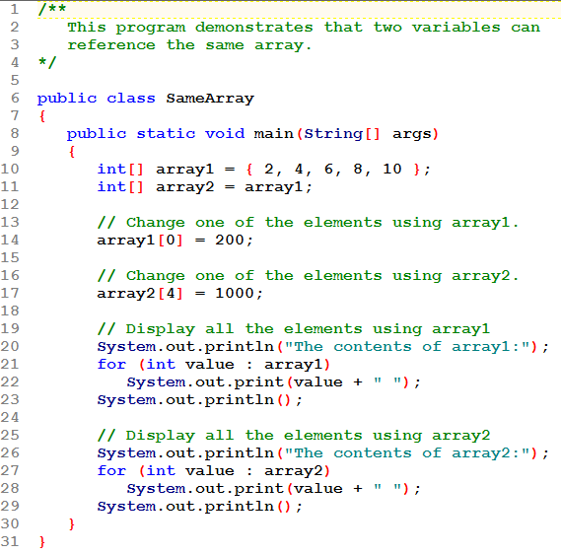
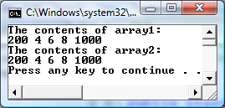
Array1 is created;
array2 = array1;
An element of each array is changed.
When the arrays are displayed, we see that the arrays are identical!
WHY? Because there is really only 1 array – it has 2 names/references!

Slide 46
Copying Arrays
You cannot copy an array by merely assigning one reference variable to another.
You need to copy the individual elements of one array to another.
int[] firstArray = {5, 10, 15, 20, 25 };
int[] secondArray = new int[firstArray.length];
for (int i = 0; i < firstArray.length; i++)
secondArray[i] = firstArray[i];
This code copies each element of firstArray to the corresponding element of secondArray.

Slide 47
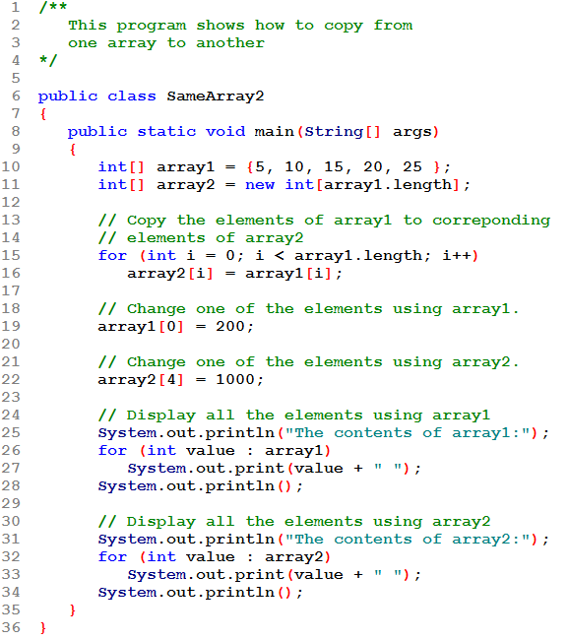
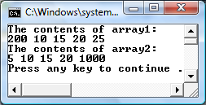
Array2 is created to be the same size as array1.
Elements are copied from array1 to array2
Now, changing a value in one array has no effect on the other! There are 2 separate arrays.

Slide 48
Passing Array Elements to a Method
When a single element of an array is passed to a method it is handled like any other variable.
See example: PassElements.java
More often you will want to write methods to process array data by passing the entire array, not just one element at a time.

Slide 49
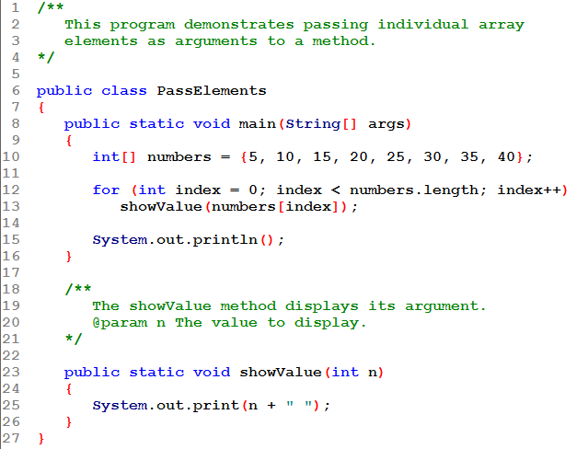
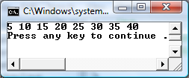
The method has an int parameter.
Each element of the array is an int and is passed to the method:
numbers[index] is a single int element of the array.

Slide 50
Passing Array Elements to a Method
Recall that a primitive parameter is always passed by value.
This means that the value of the argument is passed to the parameter
Changing the parameter has no effect on the value of the argument.
This applies even when the argument is an array element!

Slide 51
Passing Arrays as Arguments
Arrays are objects.
Their references can be passed to methods like any other object reference variable.
showArray(numbers);
5
10
15
20
25
30
35
40
Address
Example: PassArray.java
public static void showArray(int[] array)
{
for (int i = 0; i < array.length; i++)
System.out.print(array[i] + " ");
}

Slide 52
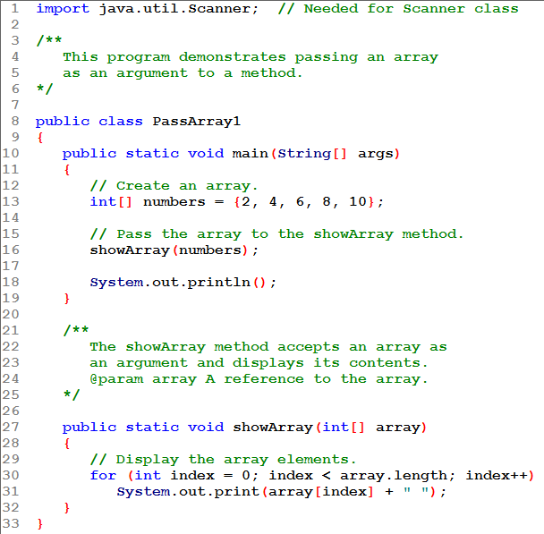
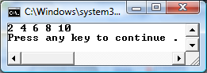
Notice the line that call the showArray() method: the array name is passed to the method:
showArray(numbers);
No brackets are used when passing an array argument!

Slide 53
Notice the header of the showArray() method:
It specifies an int[ ] parameter. No size is given: any size array of int can be passed in here.
The array's length property is used to control the loop.

Slide 54
Passing Arrays as Arguments
Note – the array parameter in a method heading does not specify the length
An array of any length can be passed to the method
Inside the method, elements of the array can be changed
An array is passed as an argument by simply putting its name in the parentheses: no brackets used there!

Slide 55
Passing Arrays as Arguments
Non-primitive (object) parameters are passed by reference.
This means that a reference (address) to the argument is passed to the parameter.
The parameter becomes another reference to the object!
So changing a property of the parameter is also changing that property of the argument.
This applies to arrays: an array argument passed to a method can be changed by the method!

Slide 56
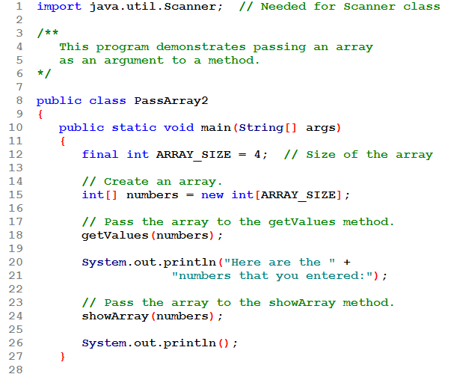
Array numbers is created without initializers, so is initially filled with 0's.
It is passed as a argument to method getValues().
When the method finishes, numbers has been filled with values.
It is passed to method showArray() where its contents are displayed.

Slide 57
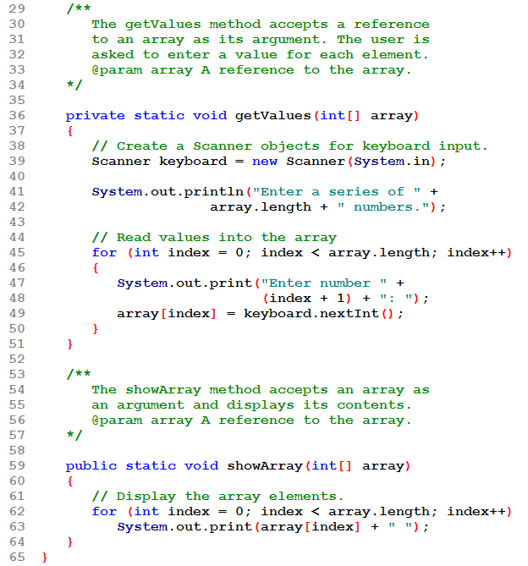
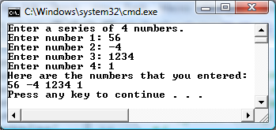
Note that getValues() is a void method. It doesn't "return" anything. But the array argument passed into it will be changed: arrays are passed by reference!

Slide 58
Some Useful Array Algorithms and Operations
We will see examples of common tasks involving arrays and the best practices for implementing them.
Comparing arrays
Summing the values in an array
Averaging the values in an array
Finding the highest and lowest value in an array

Slide 59
Comparing Arrays
The == operator determines only whether array references point to the same array object.
int[] firstArray = { 5, 10, 15, 20, 25 };
int[] secondArray = { 5, 10, 15, 20, 25 };
if (firstArray == secondArray) // This is a mistake.
System.out.println("The arrays are the same.");
else
System.out.println("The arrays are not the same.");
Since firstArray and secondArray reference separate arrays, the == operator will be false.
To compare arrays we need more code!

Slide 60
Comparing Arrays
Logic:
If the are not the same length, they are not equal
If they are the same length
Loop through the arrays, ending when
Elements that don't match are found: the arrays are not equal
Or
All elements have been checked: the arrays are equal

Slide 61
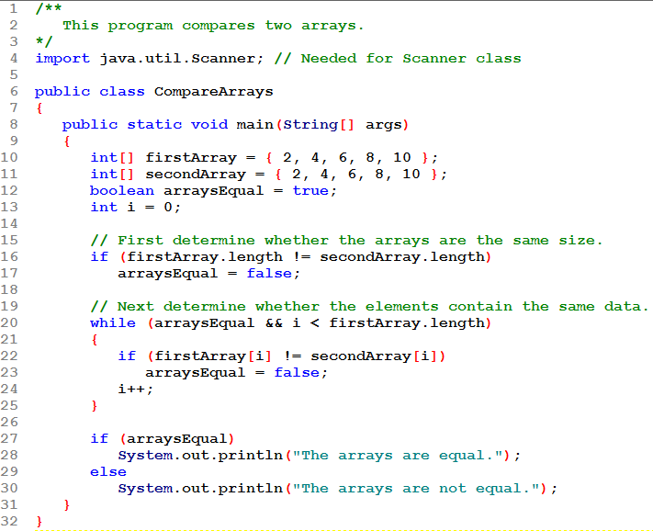
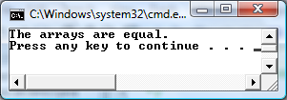
If arrays are not the same length: not equal.
Same length, loop until
find two elements that don’t match: arrays are not equal
All elements have been checked: arrays are equal

Slide 62
Useful Array Operations
Summing Array Elements:
int total = 0; // Initialize accumulator
for (int i = 0; i < units.length; i++)
total += units[i];
Averaging Array Elements:
double total = 0; // Initialize accumulator
double average; // Will hold the average
for (int i = 0; i < scores.length; i++)
total += scores[i];
average = total / scores.length;

Slide 63
Useful Array Operations
Point to note: Using the first element to initialize highest or lowest avoids any need to know about the possible range of values in the arrays!
Finding the Highest Value
int [] numbers = new int[50];
int highest = numbers[0];
for (int i = 1; i < numbers.length; i++)
{
if (numbers[i] > highest)
highest = numbers[i];
}
Finding the Lowest Value
int lowest = numbers[0];
for (int i = 1; i < numbers.length; i++)
{
if (numbers[i] < lowest)
lowest = numbers[i];
}

Slide 64
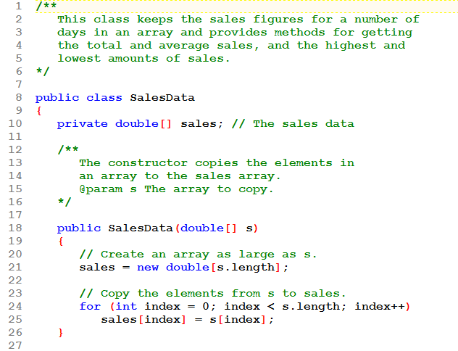
This class has just one field: an array of sales figures.
The constructor copies the array passed to it into the sales array.

Slide 65
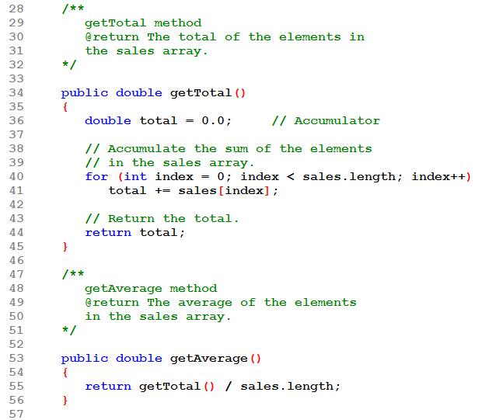
The getTotal() method adds the elements of the sales array and returns that total.
The getAverage() method uses the getTotal() method to find the sum of the elements, then divides by the length of the sales array. This is good engineering: re-use of the getTotal() method rather than duplicating its code.

Slide 66
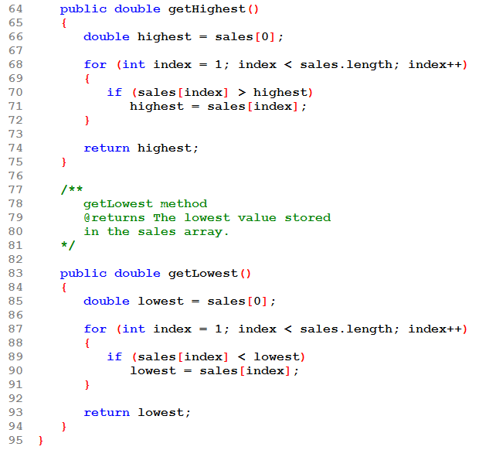
The getHighest() and getLowest() methods are similar: use the first element to initialize a local variable, then look at the rest of the array to find the highest/lowest value.

Slide 67
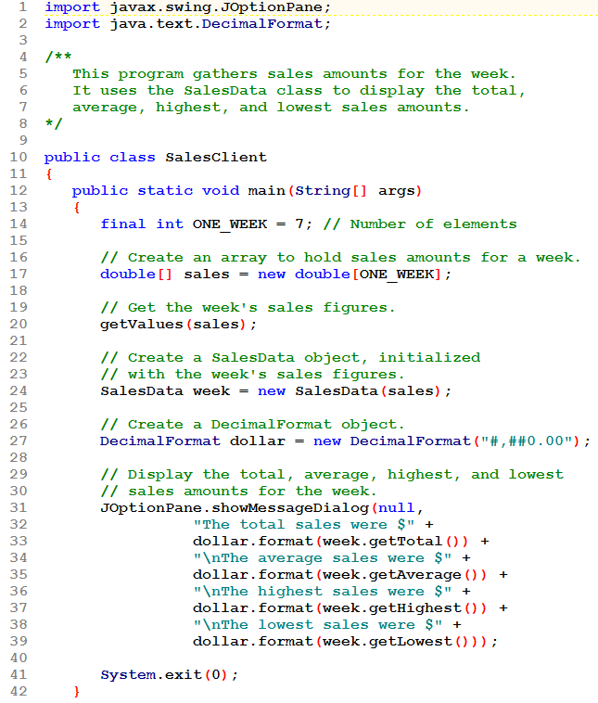
The client creates an array and uses method getValues() to fill it.
A new SalesData object is created: its array will be a copy of the array declared in the client.
The SalesData methods are used to find the various values.

Slide 68
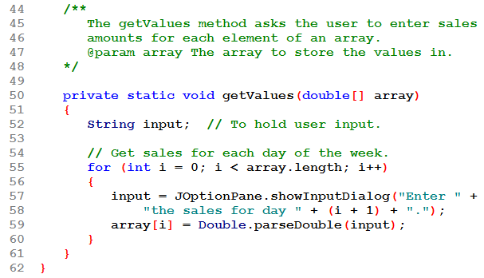
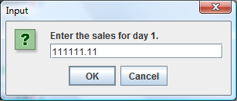
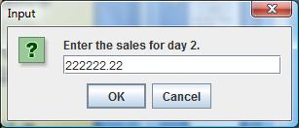
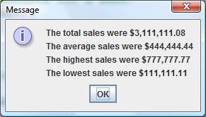
The getValues() method is similar to the one we used in an earlier example.
The array passed in here will be filled with values from the user. Since the array is passed by reference, the argument array is actually being filled.

Slide 69
In the Spotlight (pg 481)
This is a good example of creating an object that processes an array.
Task: Write a program that will input some test scores and compute the average, lowest score dropped.
Solution: The Grader class will provide the needed methods to do this. See its UML diagram on the next slide.

Slide 70
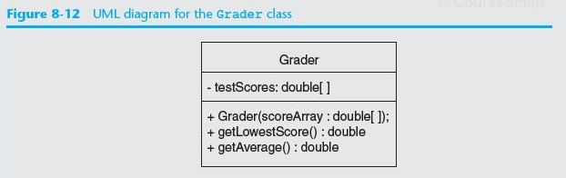
In the Spotlight (pg 481)
Field: a copy of the array of scores
Constructor: copies the array passed into it.
Methods: getLowestScore(), getAverage()

Slide 71
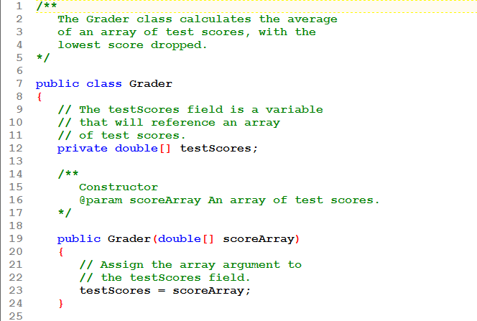
The constructor copies the array passed into it.

Slide 72
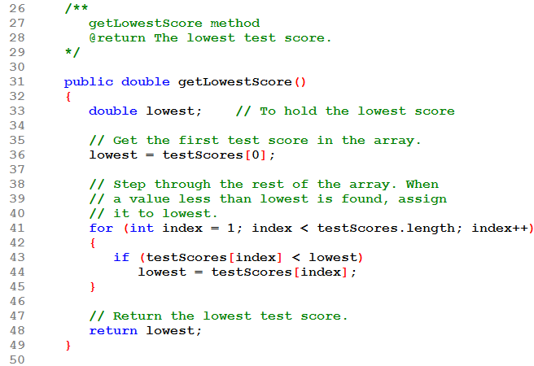
This method finds and returns the lowest score in the array.

Slide 73
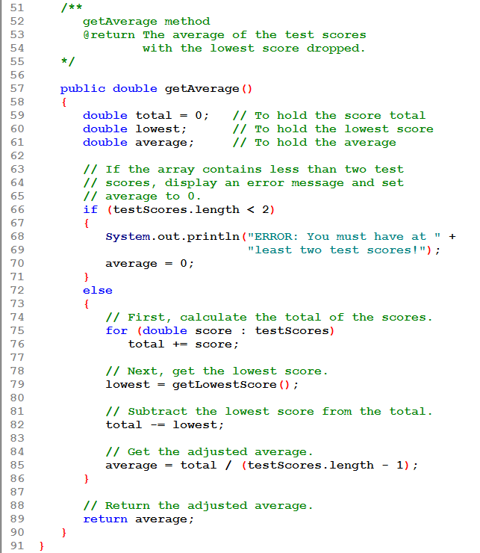
This method first checks to be sure there are at least 2 scores.
It then finds the total, subtracts the lowest, and divides by the number of scores minus one. It returns that average value.

Slide 74
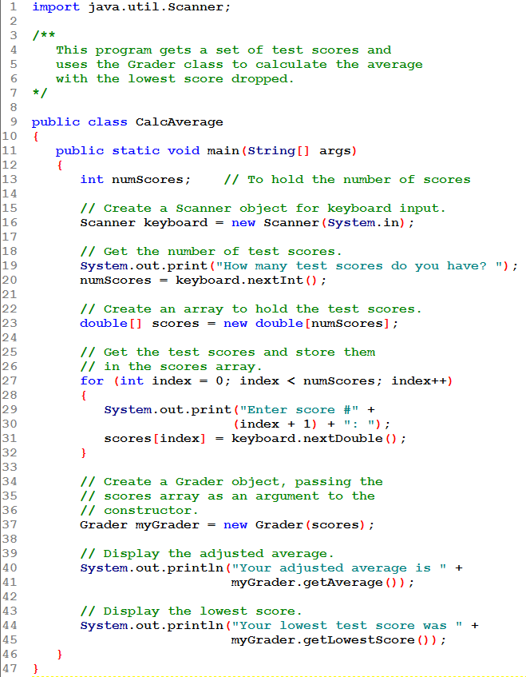
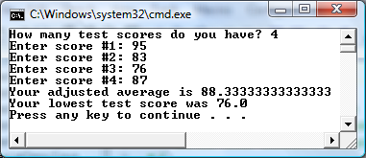
Client reads the scores into an array.
The array is used to create the Grader object.
The Grader methods are then used to display the adjusted average and the lowest score.

Slide 75
Partially Filled Arrays
What do you do if you don't know how many elements you need in your array?
Since the array size is specified when it's created, this can be a problem.
The standard solution is to create an array that will hold the largest number of values you could possibly need to store.
One problem this creates is that frequently not all elements of the array receive values: this is a partially filled array.

Slide 76
Partially Filled Arrays
If the number of values to be stored is not known and you "guess" when creating the array, here are some issues you must consider:
Frequently you will have unused elements in the array. You must be careful not to process them or treat them as "real" data.
Use a counter to determine how many "real" values are in the array, and only process that many elements.
It's possible you underestimated. You might want to ensure that your program will stop storing values rather than creating an IndexOutOfBoundsException.

Slide 77
Partially Filled Arrays
This code shows how to fill the array:
…
int[] array = new int[100];
int count = 0;
…
System.out.print("Enter a number or -1 to quit: ");
number = keyboard.nextInt();
while (count < array.length && number != -1)
{
array[count] = number;
count++;
System.out.print("Enter a number or -1 to quit: ");
number = keyboard.nextInt();
}
…
input, number and keyboard were previously declared and keyboard references a Scanner object

Slide 78
Partially Filled Arrays
It is important to only process the part of the array that is filled
It is inefficient to process unused elements.
In a numeric array, where initially the array is filled with 0's, it is often logically incorrect to proceed as if finding an element with value 0 means you have found an unused array element.
In an array of objects, exceptions will be thrown if the code attempts to process unused elements (which are null references).

Slide 79
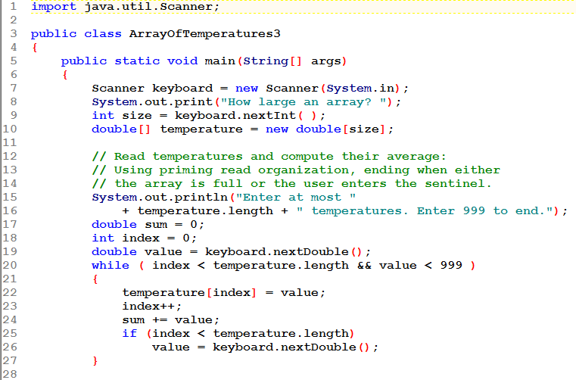
Use sentinel controlled looping to read into the array, stopping when
The array is full (index == temperature.length) OR
The sentinel is entered (999)
When the loop ends, index will show how many were entered.

Slide 80
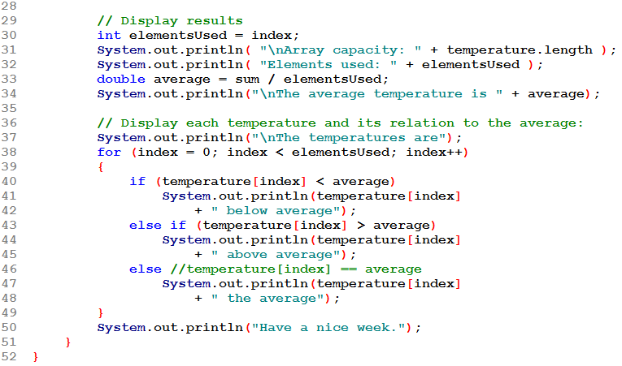
The array's capacity is temperature.length
The number of elements in use is elementsUsed (assigned from index)
Looping to process this array uses elementsUsed to control iterations!

Slide 81
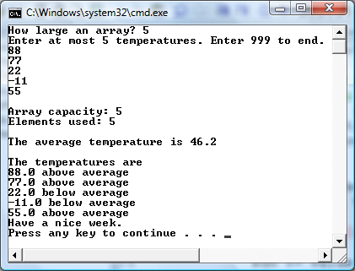
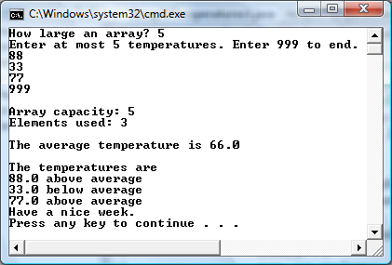
This time input looping ends when the sentinel is entered. Further array processing processes that portion of
the array that was filled.
This time input looping ends when the array is full. Further array processing processes the entire array.

Slide 82
Arrays and Files
Saving the contents of an array to a file:
int[] numbers = {10, 20, 30, 40, 50};
PrintWriter outputFile =
new PrintWriter ("Values.txt");
for (int i = 0; i < numbers.length; i++)
outputFile.println(numbers[i]);
outputFile.close();

Slide 83
Arrays and Files
When reading the contents of a file into an array, you have the "how many elements" issue to deal with.
The solution is to create an array of the size you are expecting or as large as you might possibly get.
Loop reading in values
Use the hasNext() method to be sure to stop when all values have been read, even if the array is not filled.
Use a counter to be sure you don't read and attempt to store in the array more values than it has elements.
When the loop ends, your counter will tell you how many elements were actually stored. Use the counter to process the array.

Slide 84
Arrays and Files
Reading the contents of a file into an array:
final int SIZE = 5; // Best guess as to size.
int[] numbers = new int[SIZE];
int counter = 0;
File file = new File ("Values.txt");
Scanner inputFile = new Scanner(file);
while (inputFile.hasNext() && counter < numbers.length)
{
numbers[counter] = inputFile.nextInt();
counter++;
}
inputFile.close();
// There were counter values stored in the array.

Slide 85
Returning an Array Reference
A method can return a reference to an array.
The return type of the method must be declared as an array of the right type.
public static double[] getArray()
{
double[] array = { 1.2, 2.3, 4.5, 6.7, 8.9 };
return array;
}
The getArray method is a public static method that returns an array of doubles.
See example: ReturnArray.java

Slide 86
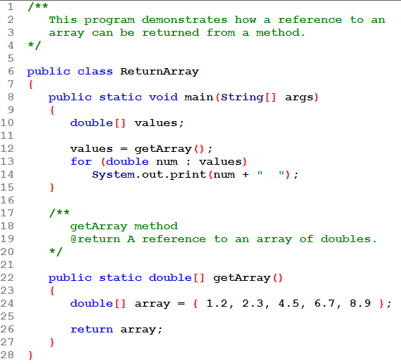
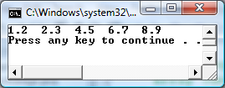
Method getArray() creates an array and then returns a reference to it.
main() assigns the returned reference to array values. Now main() can process values as it would any other array.

Slide 87
END chapter 8-2

Slide 88
String Arrays
Arrays are not limited to primitive data.
An array of String objects can be created:
String[] names = { "Bill", "Susan", "Steven", "Jean" };
Since a String variable is actually a reference to a String object, a String array actually contains an array of references to String objects.

Slide 89
String Arrays
The names variable holds
the address to the array.
A String array is an array
of references to String objects.
Address
names[0]
address
“Bill”
names[1]
address
“Susan”
names[2]
address
“Steven”
names[3]
address
“Jean”
Example: MonthDays.java

Slide 90
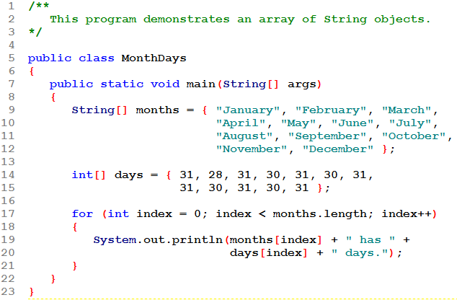
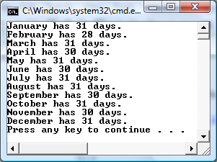
Arrays months and days are parallel arrays.

Slide 91
String Arrays
If an initialization list is not provided, the new keyword must be used to create the array:
String[] names = new String[4];
This creates an array of 4 references to String objects. Since no initializers are provided, these references are initially null.

Slide 92
String Arrays
When an array is created in this manner, each element of the array must be initialized.
names[0] = "Bill";
names[1] = "Susan";
names[2] = "Steven";
names[3] = "Jean";
The names variable holds
the address to the array.
Address
The array is an array of references to String objects. All are initially null.
names[0]
null
“Bill”
names[1]
null
“Susan”
names[2]
null
“Steven”
names[3]
null
“Jean”

Slide 93
Calling String Methods On Array Elements
String objects have several methods, including:
toUpperCase
compareTo
equals
charAt
Each element of a String array is a String object.
Methods can be called by using the array name and index as before.
System.out.println(names[0].toUpperCase());
char letter = names[3].charAt(0);

Slide 94
The length Field & The length() Method
Arrays have a final field named length.
String objects have a method named length().
To display the length of each string held in a String array:
for (int i = 0; i < names.length; i++)
System.out.println(names[i].length());
names.length is the number of elements in String array names
names[i].length() is the number of characters in String names[i]

Slide 95
The length Field & The length() Method
An array’s length is a field
You do not write a set of parentheses after its name.
A String’s length() is a method
You do write the parentheses after the name of the String class’s length() method.

Slide 96
Arrays of Objects
Because Strings are objects, we know that arrays can contain objects.
BankAccount[] accounts = new BankAccount[5];
The accounts variable holds the address
of an BankAccount array.
The array is an array of references to BankAccount objects. All are initially null.
Address
accounts[0]
null
accounts[1]
null
accounts[2]
null
accounts[3]
null
accounts[4]
null

Slide 97
Arrays of Objects
Each element needs to be initialized.
for (int i = 0; i < accounts.length; i++)
accounts[i] = new BankAccount();
The default constructor is used; each BankAccount object has a balance of 0.
The accounts variable holds the address
of a BankAccount array.
balance:
0.0
Address
balance:
0.0
accounts[0]
Address
balance:
0.0
accounts[1]
Address
balance:
0.0
accounts[2]
Address
accounts[3]
Address
balance:
0.0
accounts[4]
Address

Slide 98
Arrays of Objects
Once we have the elements referencing BankAccount objects, we can use the BankAccount methods with them:
account[0].setBalance(2500.0);
account[3].withdraw(500.00);
System.out.println(account[i].getBalance());
See example: ObjectArray.java

Slide 99
BankAccount
The UML Diagram for the BankAccount class from Chapter 6, reused in this example.
-balance:double
+BankAccount()
+BankAccount(startBalance:double)
+BankAccount(str:String)
+deposit(amount:double):void
+deposit(str:String):void
+withdraw(amount:double):void
+withdraw(str:String):void
+setBalance(b:double):void
+setBalance(str:String):void
+getBalance():double

Slide 100

First, create the BankAccount array. It is full of null references
Pass the array to the createAccounts() method. The references are no longer null!
Display the balances of each account.

Slide 101


This method loops through the elements of the BankAccount array, which are initially null references. It assigns to each element a new BankAccount object, with a balance that was read in.

Slide 102

This is the Rectangle class we worked with earlier. A few modifications have been made:
Mutators now validate values before setting the fields.
Constructor uses the mutators when setting the fields, taking advantage of the validation built into the mutators.
A toString method has been added.

Slide 103


Slide 104


Slide 105


This client creates an array of 5 Rectangle references, then uses a loop to actually create the Rectangles that go into the array.

Slide 106


A simple loop uses the toString method to display the contents of the array. The invalid length has become 1.0.

Slide 107

There is a loop that allows the user to make changes to any of the Rectangles. It uses "priming-read organization." An invalid width is entered.

Slide 108
Note that the user numbers Rectangles from 1 to size, while Java numbers them from 0 to size – 1. An adjustment is made when setting the fields. Note the use of mutators to set the fields.

Slide 109

When that loop ends, the code again displays the Rectangles using the class's toString method. Note the invalid width became 1.0

Slide 110
The Sequential Search Algorithm
A search algorithm is a method of locating a specific item in a larger collection of data.
The sequential search algorithm (aka linear search) uses a loop to:
sequentially step through an array,
compare each element with the search value, and
stop when
the value is found or
the end of the array is encountered.
See example: SearchArray.java

Slide 111

Fill the array with random numbers in range 1-100.
Then do a sequential search to see if the number 100 is in the array.
Display the array to confirm the results.
NOTE: a search reports whether a value is or is not in the array. It doesn't say how often it appears!

Slide 112


Look at each element until
the value is found or
the entire array has been searched.
NOTE: To be efficient the loop must end as soon as the value is found!

Slide 113
Introduction to Sorting Algorithms
Sort: arrange values into an order:
Alphabetical
Ascending numeric
Descending numeric
We will look at the Bubble Sort
Reference Chap 16, 953-962.

Slide 114
Bubble Sort
Concept:
Compare 1st two elements
If out of order, exchange them to put in order
Move down one element, compare 2nd and 3rd elements, exchange if necessary. Continue until end of array.
Pass through array again, exchanging as necessary
Repeat until pass made with no exchanges
BUBBLE SORT DEMO.docx

Slide 115
Example – First Pass
Array numlist3 contains:
17 | 23 | 5 | 11
compare values
17 and 23 – in correct
order, so no exchange
compare values 23 and
11 – not in correct order,
so exchange them
compare values 23 and
5 – not in correct order,
so exchange them

Slide 116
Example – Second Pass
After first pass, array numlist3 contains:
17 | 5 | 11 | 23
compare values 17 and
5 – not in correct order,
so exchange them
compare values 17 and
23 – in correct order,
so no exchange
compare values 17 and
11 – not in correct order,
so exchange them

Slide 117
Example – Third Pass
After second pass, array numlist3 contains:
5 | 11 | 17 | 23
compare values 5 and
11 – in correct order,
so no exchange
compare values 17 and
23 – in correct order,
so no exchange
compare values 11 and
17 – in correct order,
so no exchange
No exchanges, so
array is in order

Slide 118

This function compares all elements in the array on each pass. If there are 5 elements, it makes 4 comparisons on each pass.
What is the max number of passes it might require?

Slide 119

This function makes one less comparison on each pass. It is an improved bubble sort.
See how last is used.

Slide 120



A Bubble Sort Method – The rest of the program

Slide 121
Bubble Sort - Tradeoffs
Benefit:
Easy to understand and implement
Disadvantage:
Inefficient: slow for large arrays

Slide 122
Selection Sort
In a selection sort:
The smallest value in the array is located and moved to element 0.
Then the next smallest value is located and moved to element 1.
This process continues until all of the elements have been placed in their proper order.

Slide 123

Selection Sort

Slide 124

Selection Sort
. . .

Slide 125

Selection Sort
The algorithm:
See example: SelectionSortDemo.java

Slide 126


Display the unsorted array.
Pass the array to the selectionSort() method.
Display the sorted array.

Slide 127


Slide 128
Sorting Objects
You can write your own sort to put an array of objects into "order".
You will need to decide what field in the class will be used to sort the objects.
Take a sort that works on numeric arrays (like the bubbleSort() method that sorts ints) and replace the int data with your class.
Modify the code to compare the field that you want to use to put elements in order.

Slide 129
Bubble Sorting an Array of Rectangles
To sort an array of objects of any type, you have to first decide what you want to sort by.
We will sort the Rectangles by their area.
Modifications to the sort method:
Pass it the array of Rectangles
To swap elements of the array (which are Rectangles) we need a "temp" of type Rectangle.
To compare elements, we need to adjust our comparison test to access the values we are sorting by.

Slide 130

Declare and create the array of Rectangle references.

Slide 131

Create each of the Rectangles in the array.
Then sort the array.
Then list the sorted array elements and the area of each Rectangle.

Slide 132

Set up to BubbleSort:
Pass in the Rectangle array
Declare a "temp" of type Rectangle

Slide 133

Set up to BubbleSort:
Compare the areas.
Note the syntax!
Swap the array elements as needed, using temp.

Slide 134
Binary Search
A binary search:
requires an array sorted in ascending order.
starts with the element in the middle of the array.
If that element is the desired value, the search is over.
Otherwise, the value in the middle element is either greater or less than the desired value
If it is greater than the desired value, search in the first half of the array.
Otherwise, search the last half of the array.
Repeat as needed while adjusting start and end points of the search.

Slide 135

Binary Search
Algorithm:
See example: BinarySearchDemo.java

Slide 136

Start with a sorted array.
Search it for a user-specified value.
Display a message:
Not found or
The subscript where it was found.

Slide 137



Slide 138
Comparing Linear and Binary Searches
Linear Search compares each element of the array with the key until either a) it is found or b) the end of the array is encountered.
On average, since every place in the array is as likely as every other, this will take length/2 comparisons.
This is the only method you can use for an unsorted array.
Also good for small arrays.

Slide 139
Comparing Linear and Binary Searches
Binary Search uses a technique that cuts the list in half with each comparison.
The list must be sorted to use this technique
The maximum number of comparisons can be determined as follows:
It will be the exponent of the first power of two greater than the number of elements in the array.
A list of 1024 items takes at most 11 comparisons
A list of 1,000,000 takes only 20
A list of 1,000,000,000 takes only 30
array length | 1 | 2-3 | 4-7 | 8-15 | 16-31 | 32-63 | 64-127 | 128-255 | 256-511 | 512-1023
# of comps | 1 | 2 | 3 | 4 | 5 | 6 | 7 | 8 | 9 | 10

Slide 140
Command-Line Arguments
A Java program can receive arguments from the operating system command-line.
The main method has a header that looks like this:
public static void main(String[] args)
The main method receives a String array as a parameter.
The array that is passed into the args parameter comes from the operating system command-line.

Slide 141
Command-Line Arguments
To run the example:
java CommandLine How does this work?
args[0] is assigned "How"
args[0] is assigned "does"
args[0] is assigned "this"
args[0] is assigned "work?"
Example: CommandLine.java
It is not required that the name of main’s parameter array be args.

Slide 142

To set up TextPad to let you use the command line, modify the Run Java Application settings to "Prompt for parameters."

Slide 143



The array's length property indicates the number of elements it has picked up.
To run in TextPad:
When prompted, enter the command line text.
Each word in the text will become one element in the array of Strings.

Slide 144


Enclose a phrase in quotes.

Slide 145
Variable-Length Argument Lists
Java provides a special type parameter known as a variable-length argument list or vararg...
A method with a vararg parameter can accept any number of arguments (of the indicated type)
The header of such a method might be:
public static int sum(int... numbers)
The vararg parameter numbers is actually an array! Its length property will hold the number of arguments it was passed.

Slide 146
Variable-Length Argument Lists
A sample method with a vararg parameter:
public static int sum(int... numbers)
{
int total = 0; // Accumulator
// Add all the values in the numbers array.
for (int val : numbers)
total += val;
// Return the total.
return total;
}

Slide 147


The method header has the vararg parameter numbers.
The method is called 3 times, each time with a different number of arguments.
Within the method, the enhanced for is used, but a standard for would also work.

Slide 148
Variable-Length Argument Lists
The vararg parameter can be any type of array, including an array of objects.
The next program uses the BankAccount class again to demonstrate vararg parameters with object arguments.

Slide 149


The method is called 3 times, each time with a different number of BankAccount arguments.
Within the method, the enhanced for is used, but a standard for would also work.

Slide 150

This time accounts is the vararg parameter.
The accounts array is processed using a standard for loop.

Slide 151
Variable-Length Argument Lists
It's OK to mix fixed arguments with a variable-length argument list.
RULE: The vararg parameter must come last.

Slide 152


A String and a series of doubles are passed to the method.
The variable-length list must come last!

Slide 153
Variable-Length Argument Lists
You can pass an array to a vararg parameter too!

Slide 154


The vararg parameter is passed a variable number of ints, and then an array of ints.

Slide 155
END chapter 8-3

Slide 156
The ArrayList Class
Similar to an array, an ArrayList allows object storage
Unlike an array, an ArrayList object:
Automatically expands when a new item is added
Automatically shrinks when items are removed
Requires: import java.util.ArrayList;

Slide 157
Creating an ArrayList
ArrayList<String> nameList = new ArrayList<String>();
Notice the word String written inside angled brackets <>
This specifies that the ArrayList can hold String objects.
If we try to store any other type of object in this ArrayList, an error will occur.

Slide 158
Using an ArrayList: add
To populate the ArrayList, use the add method:
nameList.add("James"); // index 0
nameList.add("Catherine"); // index 1
Items in the list are indexed same as in an array.
To get the current size, call the size method
int howMany = nameList.size(); // returns 2
An array has a length property
An ArrayList has a size method.

Slide 159
Using an ArrayList: get
To access items in an ArrayList, use the get method
System.out.println( nameList.get(1) );
// Displays Catherine
In this statement 1 is the index of the item to get.
Example: ArrayListDemo1.java

Slide 160


Create the ArrayList to hold Strings.
Then add three Strings to it.
Loop, using the ArrayList's size() method, and display its elements.

Slide 161


This is the same as the previous example, but used the enhanced for loop to access the elements of the ArrayList.

Slide 162
Using an ArrayList: toString
The ArrayList class's toString method returns a string representing all items in the ArrayList
System.out.println(nameList);
This statement yields :
[James, Catherine]
See example: ArrayListToString.java

Slide 163


When an object is used as an argument to the println() method, the object's toString() method is automatically called!

Slide 164
Using an ArrayList: remove
The ArrayList class's remove method removes a designated item from the ArrayList
It's an error to remove an item using an invalid index!
nameList.remove(1);
This statement removes the second item (the item with index 1)
See example: ArrayListDemo3.java

Slide 165


Remove an item from the ArrayList.
Its size() method knows its current size.
Remaining items have been shifted to fill in the empty slot.

Slide 166
Using an ArrayList: another add
The ArrayList class's add method with one argument adds new items to the end of the ArrayList
To insert items at a location of choice, use the add method with two arguments:
nameList.add(1, "Mary");
This statement inserts the String "Mary" at index 1
See example: ArrayListDemo4.java

Slide 167


Insert an item at a specified position in an ArrayList.
Its size() method knows its current size.
Remaining items have been shifted to allow the insertion.

Slide 168
Using an ArrayList: set
To replace an existing item, use the set method:
nameList.set(1, "Becky");
This statement replaces “Mary” with “Becky”
See example: ArrayListDemo5.java

Slide 169


Replace an item at a specified position in an ArrayList.

Slide 170
Using an ArrayList: capacity
An ArrayList has a capacity, which is the number of items it can hold without increasing its size.
The default capacity of an ArrayList is 10 items.
To designate a different capacity, use a parameterized constructor: ArrayList<String> list = new ArrayList<String>(100);
Each time the ArrayList's size is changed, there is overhead (under the hood) involved. If you can reduce the number of times this happens you can increase your program's efficiency.

Slide 171
Using an ArrayList
ArrayList<BankAccount> accountList =
new ArrayList<BankAccount>();
This creates an ArrayList that can hold BankAccount objects.
You can store any type of object in an ArrayList

Slide 172
Using an ArrayList: BankAccount
// Declare a BankAccount reference
BankAccount account;
// Create an ArrayList to hold BankAccount objects. ArrayList<BankAccount> list = new ArrayList<BankAccount>(); // Add three BankAccount objects to the ArrayList. list.add(new BankAccount(100.0)); list.add(new BankAccount(500.0)); list.add(new BankAccount(1500.0)); // Display each item. for (int index = 0; index < list.size(); index++) { account = list.get(index); System.out.println("Account at index " + index + "\nBalance: " + account.getBalance()); }
See: ArrayListDemo6.java

Slide 173


Create an ArrayList of BankAccount objects.
Add BankAccounts to the list.
Display the balance of each BankAccount

Slide 174
Using an ArrayList: Integer
You can store any type of object in an ArrayList
To store numbers in an ArrayList, use the "wrapper class" associated with the needed primitive type:
ArrayList<Integer> intList = new ArrayList<Integer>;
See: ArrayListDemo7.java

Slide 175


Create an ArrayList of Integer objects.
Add ints to the list.
Access the ints using either the get() method or the enhanced for loop.

Slide 176
Some Additional ArrayList Methods
boolean | isEmpty() Tests if this list has no elements.
boolean | contains(Object elem) Returns true if this list contains the specified element.
int | indexOf(Object elem) Searches for the first occurence of the given argument, testing for equality using the equals method.
int | lastIndexOf(Object elem) Returns the index of the last occurrence of the specified object in this list.
void | clear() Removes all of the elements from this list.
protected void | removeRange(int fromIndex, int toIndex) Removes from this List all of the elements whose index is between fromIndex, inclusive and toIndex, exclusive.
void | ensureCapacity(int minCapacity) Increases the capacity of this ArrayList instance, if necessary, to ensure that it can hold at least the number of elements specified by the minimum capacity argument.
void | trimToSize() Trims the capacity of this ArrayList instance to be the list's current size.

Slide 177
Two-Dimensional Arrays
A two-dimensional array is an array of arrays.
It can be thought of as having rows and columns.
Elements are accessed by specifying 2 subscripts/indices: the row and the column
column 0
column 1
column 2
column 3
row 0
row 1
row 2

Slide 178
Two-Dimensional Arrays
two dimensional array
rows
columns
Declaring a two-dimensional array requires two sets of brackets and two size declarators
The first one is for the number of rows
The second one is for the number of columns.
double[][] scores = new double[3][4];
The two sets of brackets in the data type indicate that the scores variable will reference a two-dimensional array.
Notice that each size declarator is enclosed in its own set of brackets.

Slide 179
Accessing Two-Dimensional Array Elements
When processing the data in a two-dimensional array, each element has two subscripts:
one for its row and
another for its column.

Slide 180
Accessing Two-Dimensional Array Elements
The scores variable
holds the address of a
2D array of doubles.
column 0
column 1
column 2
column 3
Address
row 0
scores[0][0]
scores[0][1]
scores[0][2]
scores[0][3]
row 1
scores[1][0]
scores[1][1]
scores[1][2]
scores[1][3]
row 2
scores[2][0]
scores[2][1]
scores[2][2]
scores[2][3]

Slide 181
Accessing Two-Dimensional Array Elements
Accessing one of the elements in a two-dimensional array requires the use of both subscripts.
scores[2][1] = 95;
The scores variable
holds the address of a
2D array of doubles.
column 0
column 1
column 2
column 3
Address
row 0
0
0
0
0
row 1
0
0
0
0
row 2
0
95
0
0

Slide 182
Two-Dimensional Arrays
scores is a 2-D array. Its data type is double[ ][ ]
What are the elements of scores?
scores[0] is a 1-D array, the first row of scores
scores[1] is a 1-D array, the second row of scores
scores[2] is a 1-D array, the third row of scores
What is the data type of scores[n]? Its data type is double[ ]
What are the elements of scores[n]?
scores[n][0] is a double, the first element of scores[n]
scores[n][1] is a double, the second element of scores[n]
scores[n][2] is a double, the third element of scores[n]
scores[n][3] is a double, the fourth element of scores[n]
What is the data type of scores[n][m]? Its data type is double.

Slide 183
Accessing Two-Dimensional Array Elements
Programs that process two-dimensional arrays can do so with nested loops.
To fill the scores array:
for (int row = 0; row < 3; row++)
{
for (int col = 0; col < 4; col++)
{
System.out.print("Enter a score: ");
scores[row][col] = keyboard.nextDouble();
}
}
Number of rows, not the largest subscript
Number of columns, not the largest subscript
The row is set, then all columns in that row are processed. This is called "row-major" processing.

Slide 184
Accessing Two-Dimensional Array Elements
This is row-major processing again.
To print out the scores array:
for (int row = 0; row < 3; row++)
{
for (int col = 0; col < 4; col++)
{
System.out.println(scores[row][col]);
}
}
See example: CorpSales.java

Slide 185

DIVS is the number of rows; QTRS is the number of columns.
So this is row-major processing again.

Slide 186

And this is row-major processing.
This is column-major processing.

Slide 187

This is row-major processing.
This is column-major processing.

Slide 188
The length Field
Two-dimensional arrays are arrays of one-dimensional arrays.
The length field of the array gives the number of rows in the array.
Each row has a length constant that tells how many columns are in that row.

Slide 189
The length Field
double[][] scores = new double[3][4];
scores.length → 3
(there are 3 rows in the scores array)
scores[0].length → 4
(there are 4 values in scores[0])

Slide 190
Initializing a Two-Dimensional Array
Initializing a two-dimensional array requires enclosing each row’s initialization list in its own set of braces.
int[][] numbers = { {1, 2, 3}, {4, 5, 6}, {7, 8, 9} };
Java automatically creates the array and fills its elements with the initialization values.
row 0 {1, 2, 3}
row 1 {4, 5, 6}
row 2 {7, 8, 9}
Declares an array with three rows and three columns.

Slide 191
Initializing a Two-Dimensional Array
int[][] numbers = {{1, 2, 3},
{4, 5, 6},
{7, 8, 9}};
produces:
The numbers variable
holds the address of a
2D array of int values.
column 0
column 1
column 2
Address
row 0
1
2
3
row 1
4
5
6
row 2
7
8
9

Slide 192
Initializing a Two-Dimensional Array
Remember that Java actually regards a 2-D array as an array of 1-D arrays.
There is NO requirement that each row have the same length: a "jagged" array
So this is legal too:
int[][] b = {{1, 2, 3}, {4, 5}};
1 | 2 | 3
4 | 5

Slide 193
Initializing a Two-Dimensional Array
int[][] b = {{1, 2, 3}, {4, 5}};
What arrays do we have here?
array b: b.length is 2. Its elements are b[0] and b[1]
array b[0]: b[0].length is 3. Its elements are b[0][0], b[0][1], b[0][2]
array b[1]: b[1].length is 2. Its elements are b[1][0], b[1][1]
b[0]
1 | 2 | 3
4 | 5
b[1]

Slide 194
The length Field
To access the length fields of the array:
int[][] numbers = { { 1, 2, 3, 4 },
{ 5, 6, 7 },
{ 9, 10, 11, 12 } };
for (int row = 0; row < numbers.length; row++)
{
for (int col = 0; col < numbers[row].length; col++)
System.out.println(numbers[row][col]);
}
See example: Lengths.java
Number of rows Number of columns in this row.
The array can have variable length rows.

Slide 195


This uses the length property to control loops. It displays the length of the 2-D array numbers which is 3; then it displays the length of each row of the array numbers[n] which is 4.

Slide 196


This time we have a ragged array. Note that the length of each row is different!

Slide 197

Summing The Elements of a Two-Dimensional Array
Using row major processing.

Slide 198

Summing The Rows of a Two-Dimensional Array
Using row major processing.

Slide 199

Summing The Columns of a Two-Dimensional Array
Using col major processing. Why is the loop test using numbers[0].length?

Slide 200
Passing and Returning Two-Dimensional Array References
There is no difference between passing a single or two-dimensional array as an argument to a method.
The method must accept a two-dimensional array as a parameter.
See example: Pass2Darray.java

Slide 201

Pass the 2-D array to two methods.
When passing an array, the array name is the argument.
The header of the method must specify a 2-D array parameter.
int[][] array

Slide 202



Slide 203
Ragged Arrays
When the rows of a two-dimensional array are of different lengths, the array is known as a ragged array.
We have created ragged arrays by using initializers of different lengths.
You can also create a ragged array by creating a two-dimensional array with a specific number of rows, but without a specific number of columns.
int [][] ragged = new int [4][];
Then create the individual rows.
ragged[0] = new int [3];
ragged[1] = new int [4];
ragged[2] = new int [5];
ragged[3] = new int [6];

Slide 204

More Than Two Dimensions
Java does not limit the number of dimensions that an array may be.
double[][][] seats = new double[3][5][8];
More than three dimensions is hard to visualize, but can be useful in some programming problems.

Slide 205
END chapter 8-4

